Slide 1
Theories and Practices of Sustainable Development
(TPSD)
2021/22
Coordination: José Lima Santos (JLS, ISA) jlsantos.isa@gmail.com
Other lecturers: Maria da Conceição Caldeira (MC, ISA), Maria João Canadas (MJC, ISA), Ricardo Teixeira (RT, IST)

Slide 2
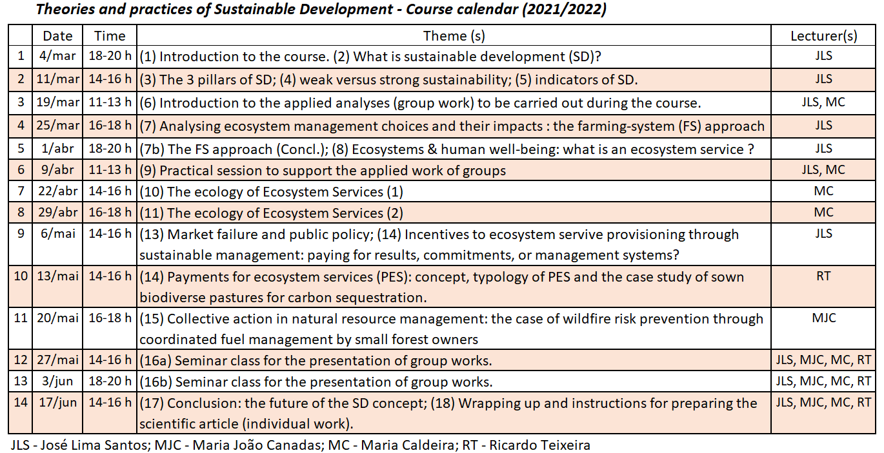

Slide 3
Evaluation method
Groups of students carry out an analysis of drivers or impacts of FS choice; and present and discuss their results in a seminar (50%)
Date for group formation and theme allocation: 19th March
Date for the submission of power points: 22nd May
Discussion of the group works: 27th May and 3rd June
Scientific article (title, abstract, introduction, selected results and discussion) individually written by each student based on the group’s results (50%)
Each student delivers the article title, accompanied by a paragraph explaining the idea until the 12th June;
This title and idea are discussed and approved in the 17th June lecture
Deadline to deliver the article: 27 th June (31st August for Trabalhadores Estudantes)

Slide 4
Theories and Practices of Sustainable Development
(TPSD)
1st lecture
26-Feb-2021
Summary:
What is sustainable development?
- first, what is development?
1. Growth and development
2. Development metrics: opulence, standard of living and subjective wellbeing/utility/happiness
3. Capabilities, functionings and freedoms; development as freedom (Amartya Sen).
4. Redefining prosperity, the growth dilemma and the decoupling myth (Tim Jackson). GDP, wellbeing and sustainability.

Slide 5
- second, What is sustainability?
1. Multiple (old and new) meanings for sustainability
2. Economy and environment: economic circuit and GDP; materials and energy flows
3. Scale and sustainability: Kenneth Boulding’s spaceship earth
4. Is there a real sustainability problem (today)? Environmental Kuznets curves: growth, technology, institutions, policies and the environment
5. The illusion of preservation: markets and global environmental impact
6. Decoupling and sustainability

Slide 6
What is development?

Slide 7
Development metrics
GDP (opulence),
subjective wellbeing/utility and happiness
standard of living (A. Sen); the capacity to lead a life that most would aspire to.
relationships between these metrics
limits of GDP as an indicator of wellbeing or standard of life

Slide 8
Weaknesses of (average) per capita GDP as an indicator of wellbeing or standard of life
Relationship between satisfaction/ wellbeing and pc GDP is not linear -> replace pc GDP with a satisfaction indicator (subjective)
pc GDP does not take into account unequality -> replace GDP with income (GDP-amortization), use the percentile 20 of income;
Household (non-market) and informal (non legal) work is not included in GDP -> estimate these produced G&S and included it in GDP;
The ecosystem and environmetal services are not included in GDP calculation -> estimate the value of those services and include this value in Green GDP

Slide 9
Weaknesses of (average) per capita GDP as an indicator of wellbeing or standard of life
Use the average between pc GDP and capacity or standard-of-living indicators – IDH / HDI
GDP includes defensive expenditure, which are indicators of underdevelopment -> calculating def. expenditure and subtracting from GDP

Slide 10
Development as freedom (Sen)
Development as an integrated process of expansion of substantive freedoms that connect with one another (p. 8).
Freedoms of different kinds can strengthen one another. (...)
this freedom-centered understanding of economics and of the process of development is very much an agent-oriented view.
With adequate social opportunities, individuals can effectively shape their own destiny and help one another.
They need not be seen primarily as passive recipients of the benefits of cunning development programmes. There is indeed a strong rationale for recognizing the positive role of free and sustainable agency – and even of constructive impatience (p.11) That is: individuals as development agents.

Slide 16
What is sustainability?

Slide 17
Multiple (old and new)
meanings for sustainability
Sustainable forest management (German foresters, 19th century);
the concept of income (John Hicks, 1950s)
overshoot and collapse (The Limits to Growth, 1972)
market failure, public intervention and the resulting cost-benefit trade offs (Pigou, 1920)
a new environment-competitiveness relationship (Porter et al 1994) – the no-trade-off hypothesis
Poverty and environmental degradation (Brudtland report)

Slide 18
Multiple (old and new)
meanings for sustainability
environmental policy and sustainable development – integration of the environment and SD in sectoral policies (Rio 1992; Cardiff process, U.E. 1998);
integration of the environment and SD in all other decision-making systems (local decision-makers, firms, consumers …)
Sustainability, public access to information and public participation (governance, Aarhus Convention 1998)
green economy / green growth … circular economy
steady state economy (H.E.Daly)
degrowth (from Georgescu-Roegen)

Slide 19
Trends in public policy styles in the EU environmental policy (1967-present)
Substantive norms (e.g.: emission standards or water quality standards) -> process norms (ex.: EIA)
Law (ex.: EU directives) -> soft law (ex.: action plans; thematic strategies, etc.)
Clear definition of the policy tool (ex.: Nitrate directive) -> clear specification of the targets to be reached and flexibility as regards policy tools to be used by member states (ex.: Habitats directive)
Command and control policy tools (ex.: emission standards) -> Economic incentives (water price; carbon markets; environmental liability, etc.).

Slide 20
Trends in EU Environmental policy ... (Cont.)
Environmental policy -> Integration of environmental objectives in the relevant sectorial policies (ex.: CAP, energy policy /biofuels; etc.) and in corporate policies (EMS, audits, life-cycle analysis, eco-labels) and local/municipal policies (Local Agenda 21)
Sustainable development: the end of environmental policy? (e.g. no need for environmental ministries?)
Green economy and green growth.
… but never steady state economy or degrowth!

Slide 21
REAL and MONETARY ECONOMIC CIRCUITS
Investment (1B)
Consumption expenditure (2)
Econ. Capital (Ke)
OUTPUT of Goods & Services (1A)
Amortization
Firms (produce)
Families (consume)
Intermediate production = Interm. consumption
INPUT of Labour, Capital and Land – Primary production factors (3)
Wages, interest and rents – Income (4)
GDP (flow) = Final production = Consumption (flow 1B) + Investment (flow 1B)
Thus: Investment = GDP – Consumption (Final production that is not consumed)
Hicksian Income (flow) = GDP – Amortization

Slide 22
GDP as an indicator of economic performance
GDP as output: flow (1), sum the monetary value of all final outputs, or sum the gross value added (GVA) of all production units
(GVA = Gross output – Intermediate consumption)
GDP as expenditure: flow (2);
GDP as income: flow (4); (Hicksian) income is GDP - depreciation of all types of capital.

Slide 23
Hicksian sustainability constraints
Consumption ≤ Hicksian Income
Hicksian income is the maximum sustainable consumption.
Investment ≥ Amortization
The creation of new capital offsets capital depreciation.
Δ Ke = α. (Investment – Amortization) ≥ 0
The stock of economic capital doesn’t decline in time, which
means that the productive capacity of the economy does not
decline in time.

Slide 24
REAL and MONETARY ECONOMIC CIRCUITS
Investment (1B)
Consumption expenditure (2)
Econ. Capital (Ke)
OUTPUT of Goods & Services (1A)
Amortization
Firms (produce)
Families (consume)
Intermediate production = Interm. consumption
INPUT of Labour, Capital and Land – Primary production factors (3)
Depletion
Natural Capital (Ke)
Wages, interest and rents – Income (4)
Total Capital = Econ. Capital + Natural Capital
K = Ke + β.Kn
Growth, regeneration

Slide 25
Extending Hicksian sustainability constraints
→ Weak sustainability rules
Δ K ≥ 0
The stock of total capital doesn’t decline in time, so:
Δ K = Δ Ke + β. Δ Kn ≥ 0
Meaning that a decline in natural capital can be offset by an increase (net investment = investment – amortization) in economic capital, and vice versa.
Basic assumption: perfect substitution between natural capital and economic capital, which means:
if natural capital declines there is always an amount of net investment (possibly very large) that will ensure that the productive capacity of the economy doesn´t decline.

Slide 26
Strong sustainability rules
Doesn’t assume substitutability of natural capital by economic capital. Under this circumstances, sustainability (that is non declining productive capacity) may require:
Δ Kn ≥ 0
(non declining natural capital)
That is: sustainable growth requires both the growth of Hicksian income (Δ (GDP – Amortization) > 0), and non declining natural capital (Δ Kn ≥ 0).

Slide 27
Including the environment into our model of the economy: the economic functions of the environment
1. Providing raw materials and other inputs (energy) to productive activities (second law of thermodynamics; global resource scarcity versus unlimited economic growth)
2. Direct provisioning of amenities and high-quality environment for human beings (direct, as not through extractive and productive activities as in 1)
3. Assimilation of waste produced by human activities of extraction, production and consumption
- First law of thermodynamics (used resources = waste flow + stock accumulation);
- Dangerousness of wastes (organic matter versus mercury or radioactive waste) and their reduction by naturally occurring processes in biosphere, hydrosphere, geosphere or atmosphere;
- The assimilation capacity of the environment (as a resource) is apparently scarcer than natural resources themselves (ex.: GGE assimilation versus oil availabilty).

Slide 28
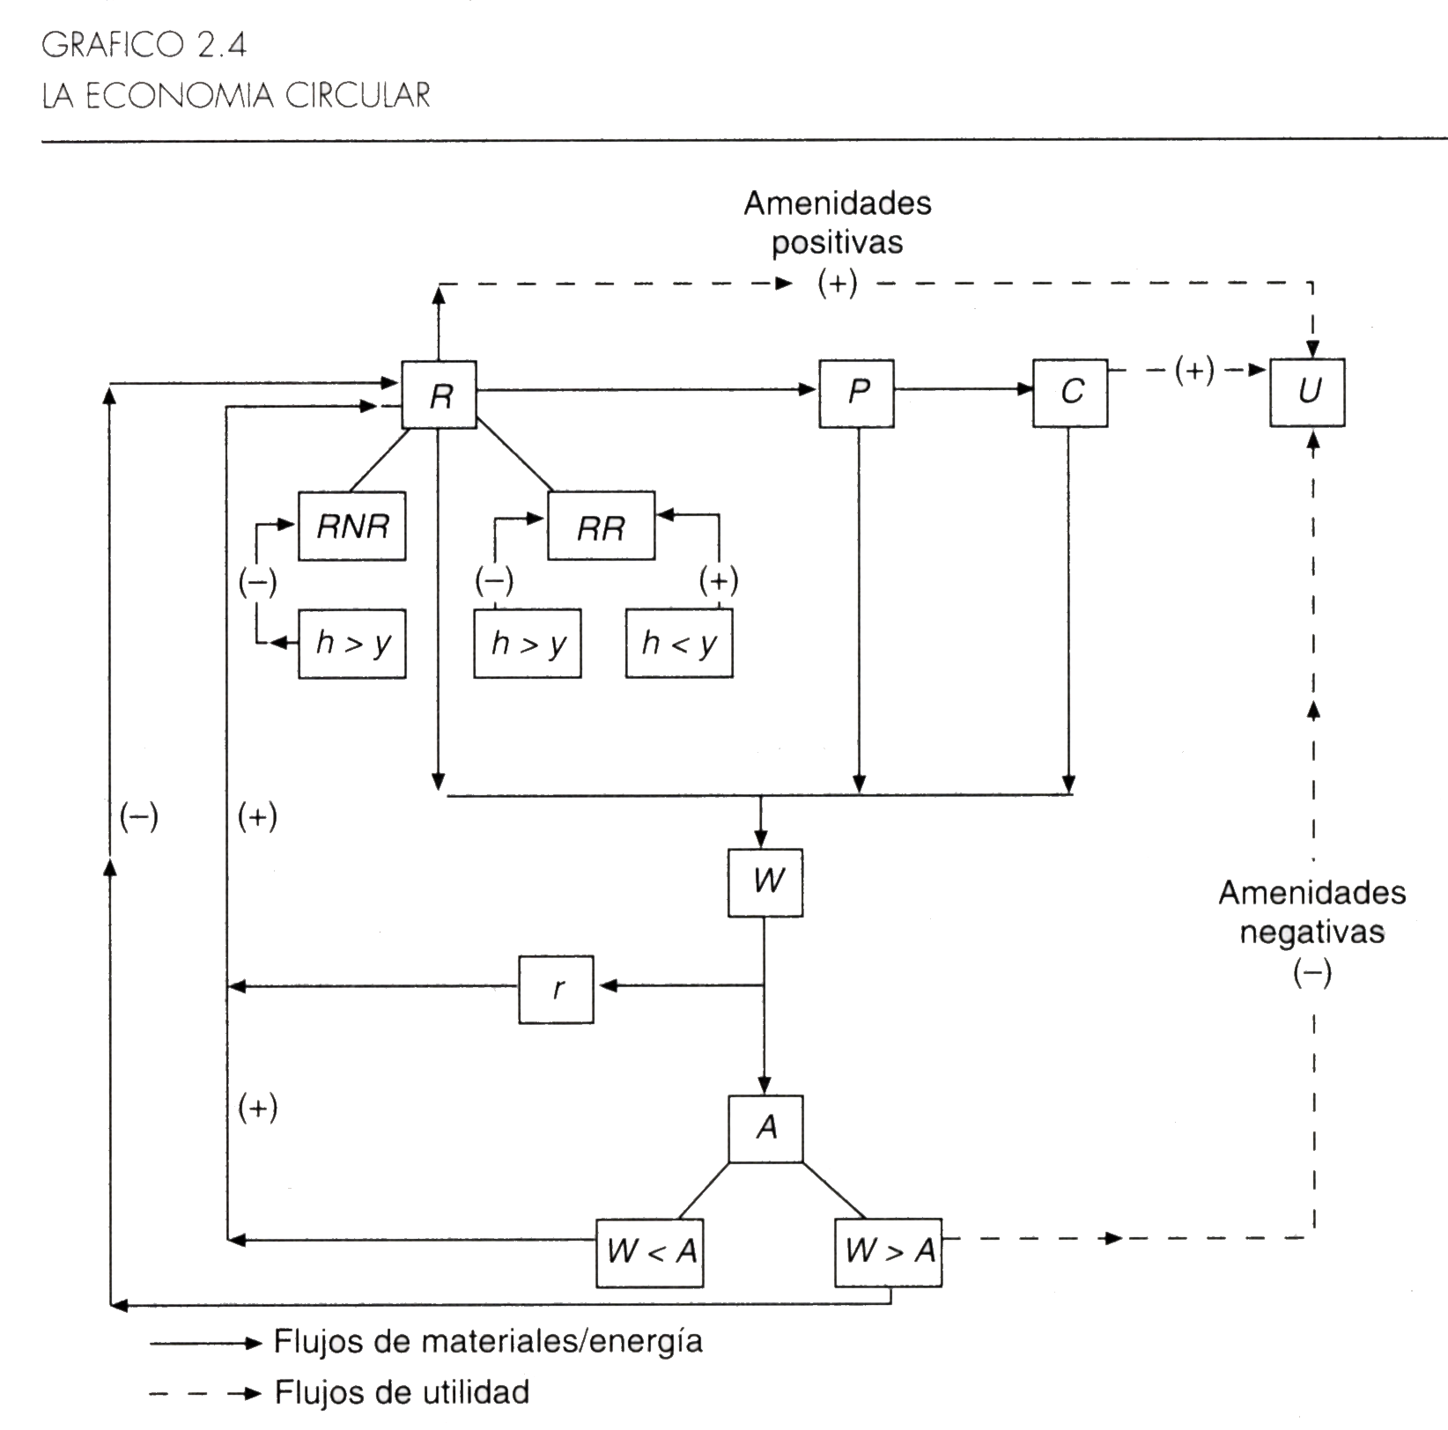

Slide 29
economic functions of the environment (Cont.)
4. Regulation of the conditions for life on earth, thus also human life (previous condition and ultimate goal of any economic activity) and economic activities involving biological processes (e.g. agriculture).
Examples:
- hydrological cycle regulation (infiltration, evaporation, transpiration soil protection, water retention in wetlands and aquifers);
regulation of bio-geo-cycles of chemical elements such as nitrogen, sulphur and carbon, and thus the composition of water and atmosphere (thus climate regulation and water ecosystem regulation)
regulation of water quality parameters (including eutrophication and water temperature/oxygenation);
ecosystem resilience, very dependent on the respective species and functional diversity and multiple biotic interactions.

Slide 30

Interdependency between functions, and feed-back on human wellbeing – or the boomerang effect
- Excessive use of the nitrogen assimilative capacity, leads to:
- Decline in renewable natural resources:
Ex 1. Nitrate pollution, eutrophication and losses in fisheries (e.g. North Sea;
Ex. 2. Nitrate pollution, degraded groundwater for providing drinking water;
- Decline in amenities, recreation services and existence values of endangered species:
Ex.3: Nitrate pollution, eutrophication, decline in fish populations, decline in populations of cherished seabirds (e.g. puffin) and seals;
- Direct feedback on production of overuse of renewable resources:
Ex. 4. Overuse of fisheries, stock depletion, fishing cost rises, higher prices, aquaculture development;

Slide 31
- Feedback effects of urban congestion on everyday amenities, quality of life and time spent in transportation;
Ex 6 quality of life and mobility in metropolitan areas,
Ex 7. congestion in recreation resources as beaches or close-to-city national parks.
Economic growth and generalized environmental scarcity– through demand expansion (demography and per capita consumption levels) and supply contraction (environmental degradation)
From the (open) cowboy economy to the (closed) spaceship economy (Kenneth Boulding)
Conclusion: The environment needs to be included in our analysis (model) of the economy, because environmental scarcity is induced by our economic choices. If we leave the environment outside, we cannot even explain how the economy works! e.g. why some prices are rising.

Slide 32
Open (cowboy) economy
... the cowboy is the symbol of unlimited flatlands and boundless, exploitative, romantic and violent behaviour, which is characteristic of open societies.
Consumption and production are seen as good things.
The performance of the economy is measured as a flow (throughput) of materials extracted from immense resource stocks and wastes given back to immense waste stocks.
If stocks are infinitely large, then this throughput (e.g. GDP or energy consumption) is in fact a possible metric for economic performance.
GDP is na approximate measurement of this total throughput.
Human wellbeing is a flow, not a stock – it refers, e.g., to the act of eating and not being in a good nutrition state.

Slide 33
Closed (spaceman) economy
... in which land became a small spaceship without unlimited resource stocks or unlimited containers for waste deposition,
... which requires circular (closed) physical/economic circuit.
Here, flows (throughput) are something to minimize, not maximize.
Economic performance cannot be measured as production/output or consumption, but the nature, quality and complexity of the total capital stock, including the state of human minds and bodies.
Maintaining this stock from the smallest possible flow (throughput) is now the goal.
Human wellbeing is described as a state (i.e., a stock) not a flow – what is now good is being well fed, not feeding in itself.

Slide 35
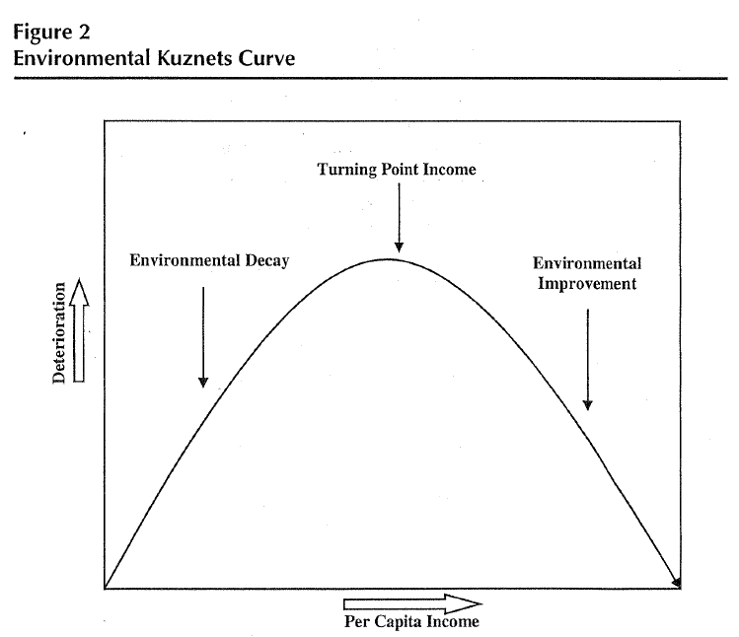

Slide 37
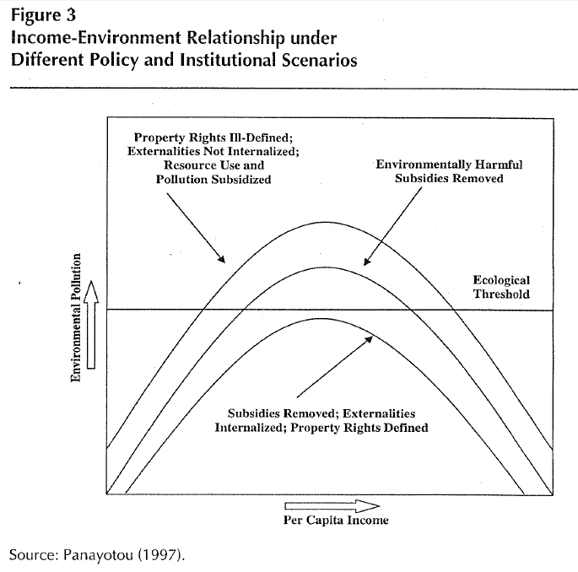

Slide 38
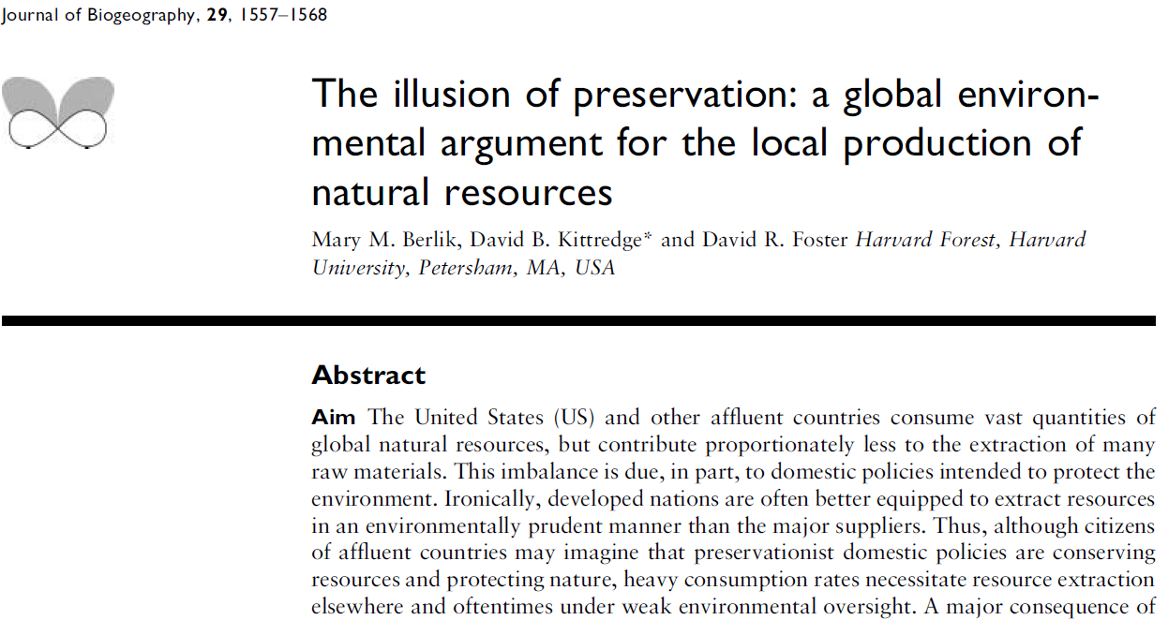

Slide 39
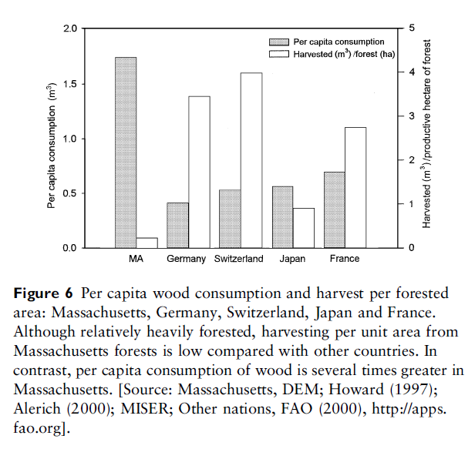

Slide 40
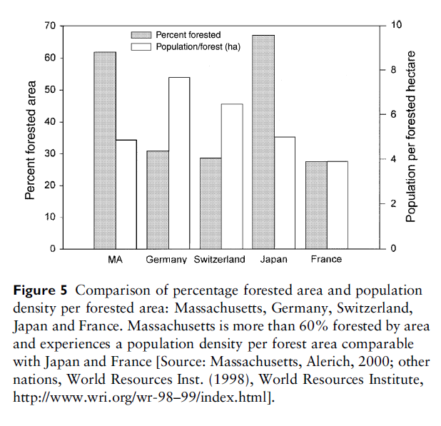

Slide 41
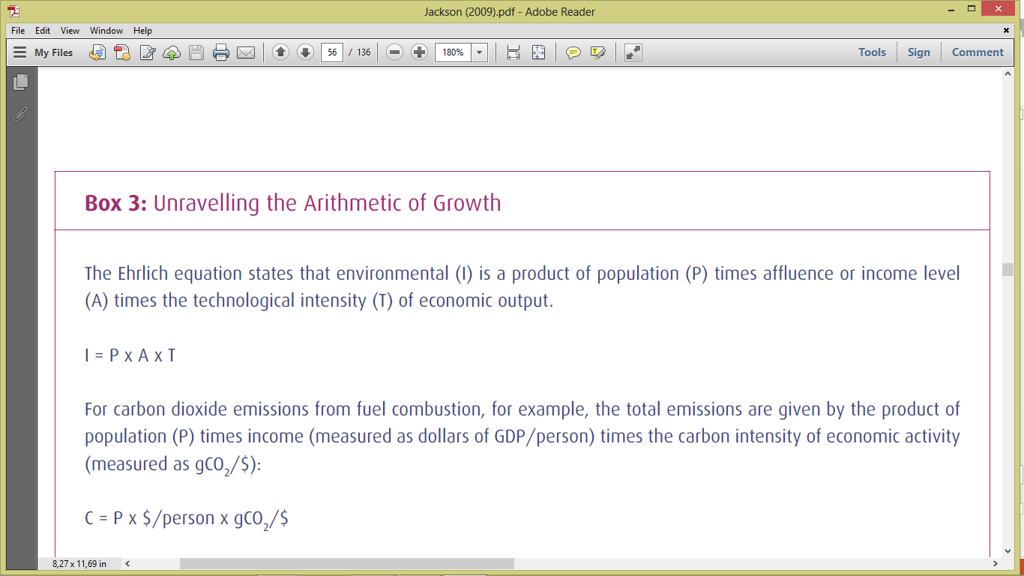

Slide 42
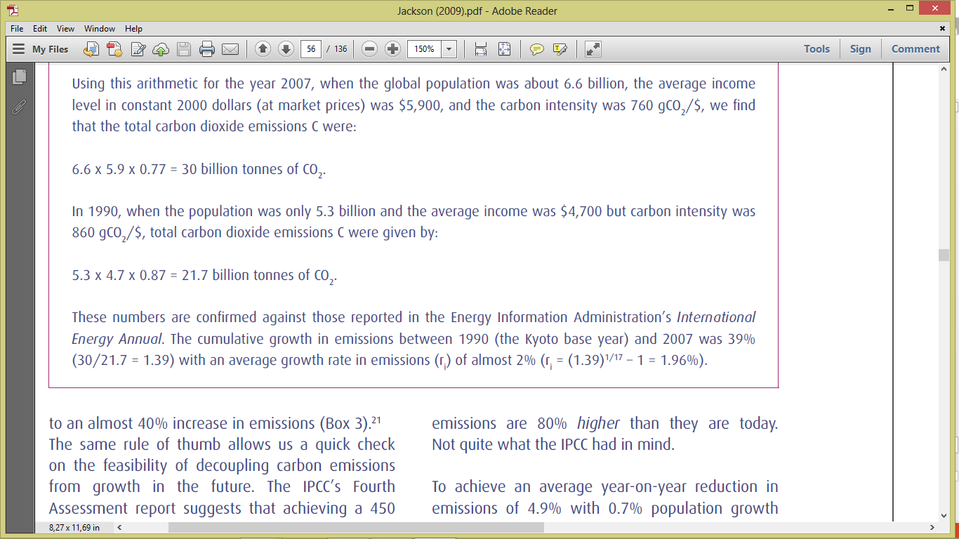

Slide 43
Decoupling economic growth from environmental pressure (more efficiency in converting natural resources into GDP)
relative decoupling
Raising GDP per unit of impact/footprint, (i.e.: resource use or waste emission). Higher efficiency in converting ecological footprint into GDP. As a result GDP grows at a faster pace than ecological footprint.
absolute decoupling
Growing GDP with a constant or declining footprint, because the efficiency in converting impact into GDP grows faster than GDP itself.

Slide 44
Sustainability
Sustainable resource extraction flows (strong sustainability):
Rule 1: extraction <= growth (renewable resources) => constant or increasing resource stock;
Rule 2: extraction of non-renewable resources <= growth of substitute renewable resources
In both cases, the stock of natural capital is non-declining.
Natural capital decline <= growth of substitute economic capital (weak sustainability);
Sustainability is a condition of non-declining total capital (economic, natural, human and social), in which there is not a long term decline of the productive capacity of the economy.

